Slide 1
Key Challenges for Contemporary HRM
Session 3/10
Part II

Slide 2
What are the key challenges for HRM?
Changing employment relations and managing the
psychological contract

Slide 3
Changing competitive landscapes and employment relations - Challenges for HRM
Changing promises and expectations
  Under the old deal the employee received job security and the possibility of promotion in return for good performance and commitment. Under the new deal workers are asked to exchange performance for competitive wages and marketable skills.

Slide 4
The new deal at work
Old deal | New deal
Employment means having a long-term permanent contract with an organization Careers unfold within one or few organizations Careers are managed by organizations People develop firm specific skills Careers follow predictable stages Success is associated with hierarchical career progression, power and income Commitment to one’s organization The individual adopts the values of his or her organization. | Employment is a temporary state (increase of temporary work) Careers are played out across the boundaries of jobs, functions and organizations People take control and manage their own careers People acquire marketable skills (employability) Careers evolve through continuous cycles of learning and training Success is psychological and self-defined Commitment with one’s personal interests, occupation or industry The career is driven by one’s values and beliefs

Slide 5
The Psychological Contract
“A set of unwritten reciprocal expectations between an individual employee and the organization” (Schein, 1978)
“The perceptions of both parties to the employment relationship - organisation and individual - of the reciprocal promises and obligations implied in that relationship.” (Guest & Conway, 2002)
Challenges for HRM: How to manage employee expectations in a changing work environment?

Slide 6
What are the key challenges for HRM?
The “new career”and increasing workforce mobility

Slide 7
Changing work Values and Career Preferences
The rise of protean and boundaryless careers?
Protean career
“one in which the person, not the organization, is in charge, the core values are freedom and growth, and the main success criteria are subjective (psychological success) vs. objective (position, salary)” (Hall, 2004: 4)
Boundaryless career
A career that moves across the boundaries of different employers. (Arthur, 1994)
People should focus on developing marketable skills rather than firm-specific skills (knowledge is portable)
Employment is “a temporary state, or the current manifestation of long term employability” (Arthur and Rousseau, 1996: 374)
Workers should not expect to stay with their employers their entire careers.

Slide 8
The rise of protean and boundaryless careers?
Time |  | 1992 | 1993 | 1994 | 1995 | 1996 | 1997 | 1998 | 1999 | 2000 | 2001 | 2002 | 2003 | 2004 | 2005 | 2006 | 2007 | 2008 | 2009 | 2010 | 2011 | 2012 | 2013 | 2014 | 2015 | 2016 | 2017
Country
France |  | 10,5 | 10,7 | 10,8 | 10,8 | 10,9 | 11,0 | 11,3 | 11,2 | 10,9 | 10,7 | 10,8 | 11,1 | 11,1 | 11,2 | 11,1 | 11,0 | 10,9 | 10,9 | 11,0 | 11,0 | 11,1 | 11,5 | 11,4 | 11,4 | 11,4 | 11,3
Germany |  | .. | .. | .. | .. | 10,0 | 10,1 | 10,4 | 10,3 | 10,0 | 10,0 | 10,1 | 10,3 | 10,6 | 10,3 | 10,4 | 10,4 | 10,4 | 10,6 | 10,7 | 10,8 | 10,8 | 11,0 | 11,0 | 11,0 | 11,0 | 10,9
Ireland |  | 11,1 | 11,2 | 11,0 | 10,8 | 10,7 | 10,2 | 9,8 | 9,2 | 9,2 | 9,2 | 9,3 | 9,3 | 8,7 | 8,5 | 8,8 | 8,7 | 8,9 | 9,4 | 9,8 | 9,9 | 10,0 | 10,3 | 10,4 | 10,5 | 10,3 | 9,7
Portugal |  | 11,1 | 12,6 | 12,4 | 12,3 | 12,3 | 12,4 | 11,6 | 12,0 | 11,6 | 11,5 | 11,6 | 11,9 | 12,0 | 12,2 | 12,2 | 12,1 | 12,3 | 12,6 | 12,5 | 12,4 | 12,9 | 13,0 | 12,6 | 12,6 | 12,5 | 12,5
Spain |  | 9,7 | 10,0 | 9,8 | 9,6 | 9,7 | 9,6 | 9,7 | 9,8 | 9,4 | 9,3 | 9,2 | 9,1 | 9,0 | 9,0 | 9,0 | 8,8 | 9,1 | 9,6 | 9,9 | 10,3 | 10,7 | 10,9 | 10,8 | 10,9 | 10,8 | 10,7
United Kingdom |  | 8,1 | 8,2 | 8,3 | 8,2 | 8,2 | 8,0 | 8,2 | 8,3 | 7,9 | 7,9 | 7,9 | 8,0 | 7,9 | 8,0 | 8,1 | 8,1 | 8,1 | 8,4 | 8,6 | 8,6 | 8,7 | 8,8 | 8,8 | 8,6 | 8,6 | 8,6
Job tenure in years. (Source: OECD)
Even if there isn’t a decline in job tenure the way people think about their careers may have changed
We need to look at career attitudes and its impact on employee and organizational outcomes

Slide 9
Changing work Values and Career Preferences
Challenges for HRM:
Do people with high protean and boundaryless careers perform as well as those seeking organizational careers?
To what extent can organizations manage individuals with high protean and boundaryless careers using sets of high commitment HR practices?

Slide 10
Research questions
Do protean and boundaryless career attitudes lead to more positive employee outcomes?
Do protean and boundaryless career attitudes lead to more positive organizational outcomes?
How best can organizations manage individuals with high protean and boundaryless career attitudes?

Slide 11
Study Aims
The study explores:
  The link between protean and boundaryless career attitudes and employee well-being related outcomes
    Job satisfaction
    Career satisfaction
    Life satisfaction
  The link between protean and boundaryless career attitudes and performance outcomes:
    Job Performance
    OCBs
    Retention (ITQ + Commitment)
  The moderating role of High commitment HRM in the link between new career attitudes and organizational outcomes

Slide 12
Methods - Sample and procedure
Questionnaire survey of a sample of workers in 19 private organizations in Portugal
Organizational size – from < 50 to > 3000 employees
655 subordinate-supervisor dyads were collected
Mean age = 37 years (SD = 9.13)
52.5%men
63.4% partnered
Mean job tenure = 5.1 years (SD = 6.6)
80.7% full-time permanent workers; 3.3% part-time
23.3% described themselves as senior management, 26% as line managers, 31.2% as administrative workers and 19.3% as manual workers.

Slide 13
Measures
Control Variables
  Demographic variables
  Employment experience variables (e.g. employment contract)
  Organizational variables (size)
Supervisor rated performance
  Job Performance – 7 items from Williams & Anderson (1991). A sample item is “This employee adequately completes assigned duties” (α=.90)
  OCBO – 4 items from Lee & Allen (2002). A sample item “This employee attends functions that are not required but that help the organizational image” (α=.86)
  OCBI - 4 items from Lee & Allen (2002). A sample item “This employee gives his time to help others who have work-related problems”) (α=.87)

Slide 14
Measures
Self-report data
Boundaryless career attitudes - 4 items from Briscoe et al. (2006) organizational carer mobility preference scale. A sample item is “I like the predictability that comes with working continuously for the same organization (R)” (α=.78)
Protean career attitudes - 4 items from Briscoe et al. (2006) self-directed career management scale. A sample item is “Overall, I have a very independent, self-directed career”. (α=.73)
High commitment human resource management practices – 25 items covering 8 main areas (e.g. job design; performance related pay, etc.) (α=.88)
Intention to quit - 3 items adapted from Price et al. (1992). A sample item is “If I could I would quit today”. (α=.86)
Organizational commitment - 3 items from Meyer and Allen’s (1997). A sample item is “I do not feel a strong sense of ‘belonging’ to my organization (R)” (α=.73)
Job satisfaction - 3 items adapted from Kim, Price, Mueller and Watson (1996). A sample item is “Most days I am enthusiastic about my job” (α=.76)
Career satisfaction - 4 items adapted from Greenhaus, Parasuraman and Wormley (1990). A sample item is “Overall I am satisfied with my career so far”. (α=.89)
Life satisfaction - 4 items from Diener et al.’s (1985) Satisfaction with Life Scale. A sample item is “In most ways, my life is close to ideal”. (α=.89)

Slide 15
Do protean and boundaryless career attitudes lead to more positive employee outcomes?

Slide 16
Findings
Hierarchical regression of protean and boundaryless career attitudes on career, job and life satisfaction
Independent Variables | Job Satisfaction |  | Career Satisfaction |  | Life Satisfaction
 | Model 1 | Model 2 | Model 1 | Model 2 | Model 1 | Model 2
Demographics (age, gender, marital, tenure, education, etc.) and Employment experience variables (contract, income, working hours); Organization size | .
Human Resource Management Practices | .47*** | .31*** | .49*** | .36*** | .41*** | .30***
Boundaryless Career Attitudes |  | -.30*** |  | -.28*** |  | -.22**
Protean Career Attitudes |  | .23** |  | .16** |  | .16*
∆ R² | .26*** | .11*** | .29*** | .08*** | .25*** | .05**
R² | .37 |  | .37 |  | .30
Protean Career Attitudes are associated with positive attitudes
  Autonomy and control are associated with positive employee attitudes
Boundaryless Career Attitudes are associated with negative employee attitudes
  Are potentially associated with restlessness and the constant search of alternatives in the market. May be associated with a sense of relative deprivation

Slide 17
Do protean and boundaryless career attitudes lead to more positive organizational outcomes?

Slide 18
Findings
Hierarchical regression of protean and boundaryless career attitudes on job performance, OCB, organizational commitment and intention to quit
Independent Variables | Job Performance |  | OCBO |  | OCBI |  | Organizational Commitment |  | Intention to Quit
 | Model 1 (controls) | Model 2 | Model 1 (controls) | Model 2 | Model 1 (controls) | Model 2 | Model 1 (controls) | Model 2 | Model 1 (controls) | Model 2
Boundaryless Career Attitudes |  | .00 |  | .04 |  | -.04 |  | -.16** |  | .44***
Protean Career Attitudes |  | .16* |  | .22** |  | .14 |  | .04 |  | -.00
∆ R² | .18*** | .02 | .18*** | .04* | .20*** | .01 | .43*** | .03* | .36*** | .16***
R² | .25 |  | .28 |  | .24 |  | .46 |  | .52
Boundaryless career attitudes are not significantly associated with in-role and extra-role performance and are associated with lower commitment and higher intention to quit;
Protean career attitudes are significantly associated with job performance and OCBO

Slide 19
Can organizations manage individuals with high protean and boundaryless career attitudes?

Slide 20
There are sound reasons why organizations might wish to influence protean and boundaryless attitudes.
  Protean attitude
    is associated with control and proactivity and can be an advantage for an organization
  Boundaryless attitude
    Increased risk of turnover may be a cause for concern for organizations.
What is the role of high commitment HRM in managing “new career” attitudes?

Slide 21
Findings
Hierarchical regression of protean and boundaryless career attitudes and interactions between career attitudes and human resource management practices on job performance and OCB
Independent Variables | Job Performance |  |  | OCBO |  |  | OCBI
 | Model 1 | Model 2 | Model 3 | Model 1 | Model 2 | Model 3 | Model 1 | Model 2 | Model 3
Demographics + work experience + organization size
HRM | .06 | .00 | .07 | .09 | .02 | .06 | .24** | .18* | .23**
Boundaryless Career Attitudes |  | .00 | -.01 |  | .04 | .01 |  | -.04 | -.05
Protean Career Attitudes |  | .16* | .18* |  | .22** | .20** |  | .14 | .15*
Int. HRM & Boundaryless Career Attitudes |  |  | -.23** |  |  | -.26*** |  |  | -.15*
Int. HRM & Protean Career Attitudes |  |  | .04 |  |  | -.09 |  |  | .04
∆ R² | .18*** | .02 | .05** | .18*** | .04* | .06** | .20*** | .01 | .03*
R² | .25 |  |  | .28 |  |  | .24

Slide 22
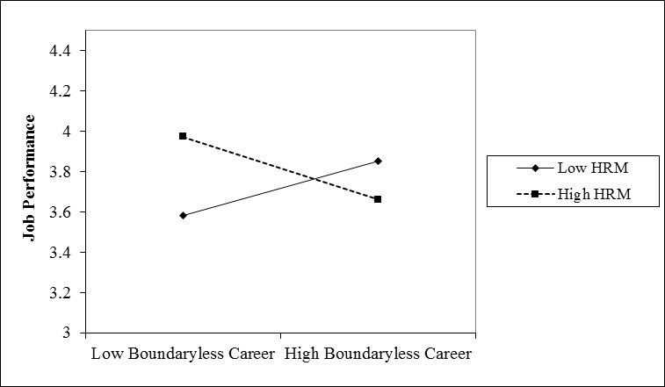
Findings
Figure 1 – Interaction effect of boundaryless career attitudes and HR practices on Job Performance
In organizations adopting a “low road” approach to HRM, individuals with high boundaryless career attitudes will perform better than those seeking organizational careers.

Slide 23
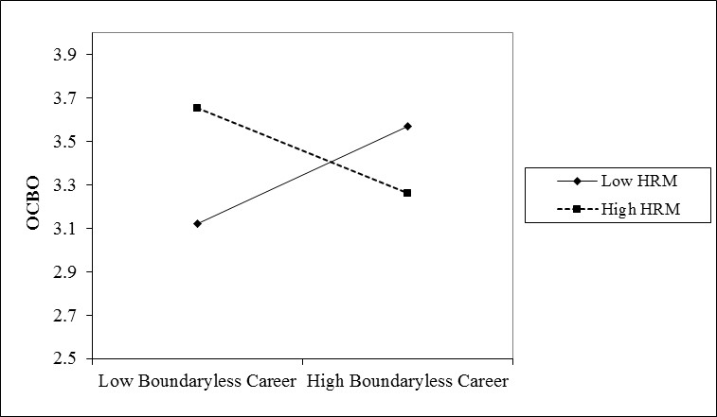
Findings
Figure 2 – Interaction effect of boundaryless career attitudes and HR practices on OCBO
In organizations adopting a “low road” approach to HRM, individuals with high boundaryless career attitudes will display more discretionary behaviours towards the organization than employees seeking organizational careers

Slide 24
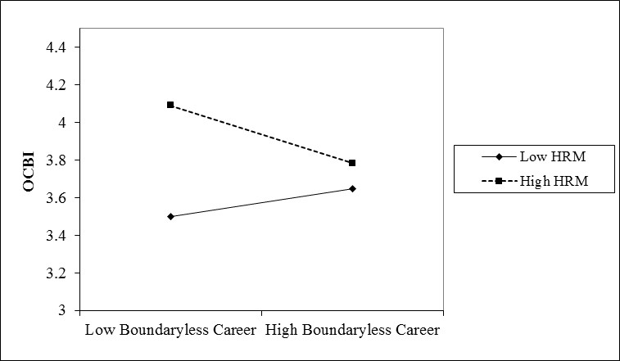
Findings
Figure 3 – Interaction effect of boundaryless career attitudes and HR practices on OCBI
In organizations adopting a “high road” approach to HRM, employees seeking organizational careers display more citizenship behaviours directed at their co-workers than those seeking boundaryless careers

Slide 25
Implications
Protean career attitudes were associated with positive experiences for workers (in line with other studies) and were positively associated with job performance and OCB (WIN-WIN)
Employees with high boundaryless career attitudes reported lower levels of career, job and life satisfaction, were less committed and more willing to leave their employer (LOSE-LOSE)
  Challenges the key assumption underpinning the “new career” literature that boundarylessness is more satisfying for employees
HR practices have a limited impact in managing the careers of individuals with boundaryless career attitudes, though their importance is significant for those seeking organizational careers.
  Challenges for organizations seeking to retain marketable high skilled workers

Slide 26
What are the key challenges for HRM?
Attracting and managing a diverse workforce

Slide 27
What are the key challenges for HRM?
Is diversity good for organizations?
  Access padlet using the link below
  Login in via Microsoft and using your KCL credentials

